Slide 1
Agenda: Wednesday April 5, 2017
Collect Monday’s work
Warm up
Group grades (2nd & 4th)
Review language and meaning in Act 2
Mind Maps
Act 3
ALL ASSIGNMENTS FOR 2ND 6 WEEKS DUE FRIDAY 4/7

Slide 2
Warm Up: 4/3-4/5
Warm Up: 4/3
1. Why does Shakespeare often use the nature motif to convey his message?
2. What is a motif, and which motifs are we focused on for Act 2?
Warm Up 4/5: ½ SHEET OF PAPER
What are a few things you are proud of having accomplished this year (in class), and what do you still want to accomplish before the school year ends?
You will be turning this in.

Slide 3
TKAM Group Grades
Anonymously grade the members of your group, including yourself. Grades are %/100
Dawan | Miles | Ayden | Mathew | Ben | Alex S. | Vincent
Kaleb | Raina | Topher | Christina | Osiel | Aimee | Dylan
 | Autumn | Jacob | Michael | Blake | Cayden | Maddie
 | Bennie | Keelyn | Oswaldo | Tristen | Andrew | Adam
Ana | Abby | Maya K. | Tyler | Skylar
Phil | Dre | Gabe | Andrick | Deon
Cielo & Rachel | Maya R. | Seriah | Alex T. | Gracie
Alex W. | Ricardo | Gisselle | Nyasia | Fabian
Tristan | Matthew | Espy | Allie | Steph | Steven
Caleb | Brock | Cesar | Destiny | Brandon | Alejandro
Janee’ | Mylissa | Anthony | Elexis | Alondra | Chris
Jake | Carlos |  | Wambdi | Brad | Maddy

Slide 4
Work from Monday 4/4
Warm Up: 4/3
1. Why does Shakespeare often use the nature motif to convey his message?
2. What is a motif, and which motifs are we focused on for Act 2?
1. Finish scene 2.
2. Scene 3 opens with Friar Laurence’s soliloquy: “The gray-eyed morn smiles on the frowning night…In man as rude as herbs- grace and rude will”
A. Put the soliloquy in modern language (like we did with the Prologue).
You may modernize line by line or every 2 lines.
B. Within this soliloquy identify 1 example of each of the motifs (nature, love or hate, light or dark, and language/word play.
C. Read the rest of the scene and identify any questions you may have (put this under your modernization and examples of motifs.
3. Read Act 2, scene 4-6 (basically finish the act)
A. What are the most important things that happen between scenes 4-6?
B. What motifs have you found?
4. Based on your chosen motifs, create a rough draft of your mind map. R
A. Remember, ACT 2 needs to be in the middle. Stemming out from the middle will be your 4 categories of motifs: nature, light OR dark, love OR hate, language/word play.
ALL OF YOUR ASSIGNMENTS FOR THE DAY SHOULD BE ON 1-2 PIECES OF PAPER THAT YOU WILL TURN IN ON WEDNESDAY 4/5.

Slide 5
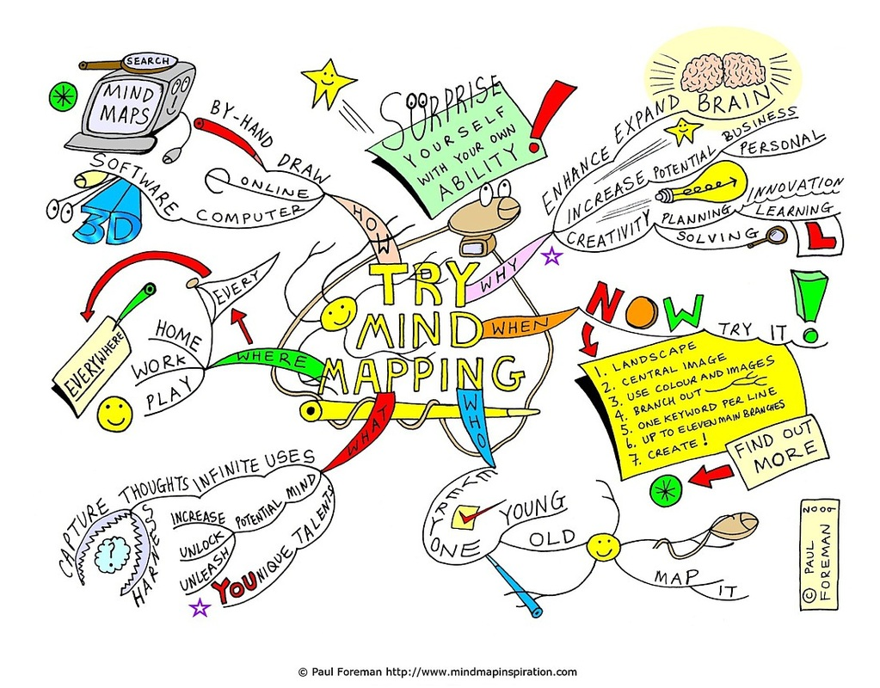
Review Shakespeare language in Act 2
Work on your mind maps.

Slide 6
Agenda: Friday April 7, 2017
ALL ASSIGNMENTS FOR 2ND 6 WEEKS DUE TODAY!
1. Finish Mind Map
Must haves:
4 quotes per motif
Explanations of all 4 quotes
Image/explanation of all 4 quotes
Your ideas or what it represents to you
Connections back to Romeo and Juliet
Creativity and color
2. Reflection: Defend or explain the following in a paragraph. Connect your motif to a thematic concept. Identify your quote for your motif and how it is categorized on your mind map?
Begin paragraph with: In “Romeo and Juliet” Act 2, William Shakespeare uses…
3. Make up work

Slide 7
Act IV,

